Slide 1
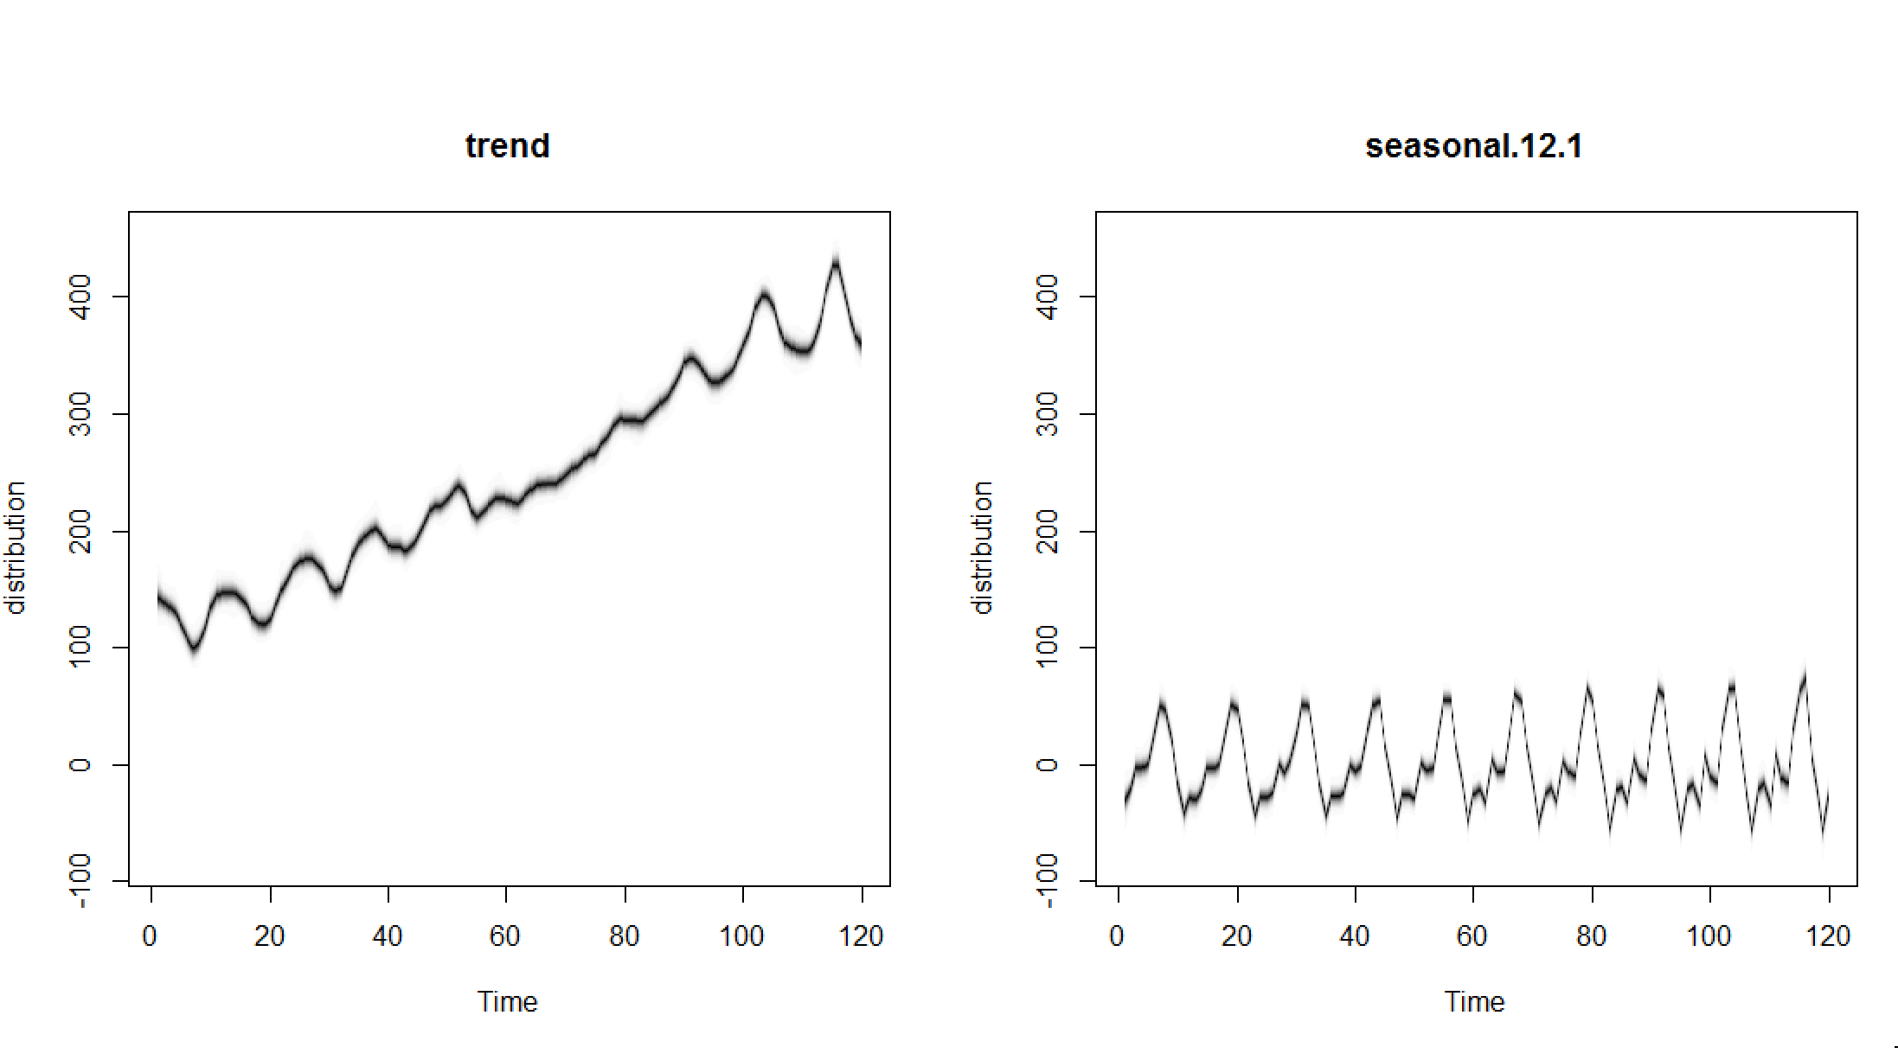
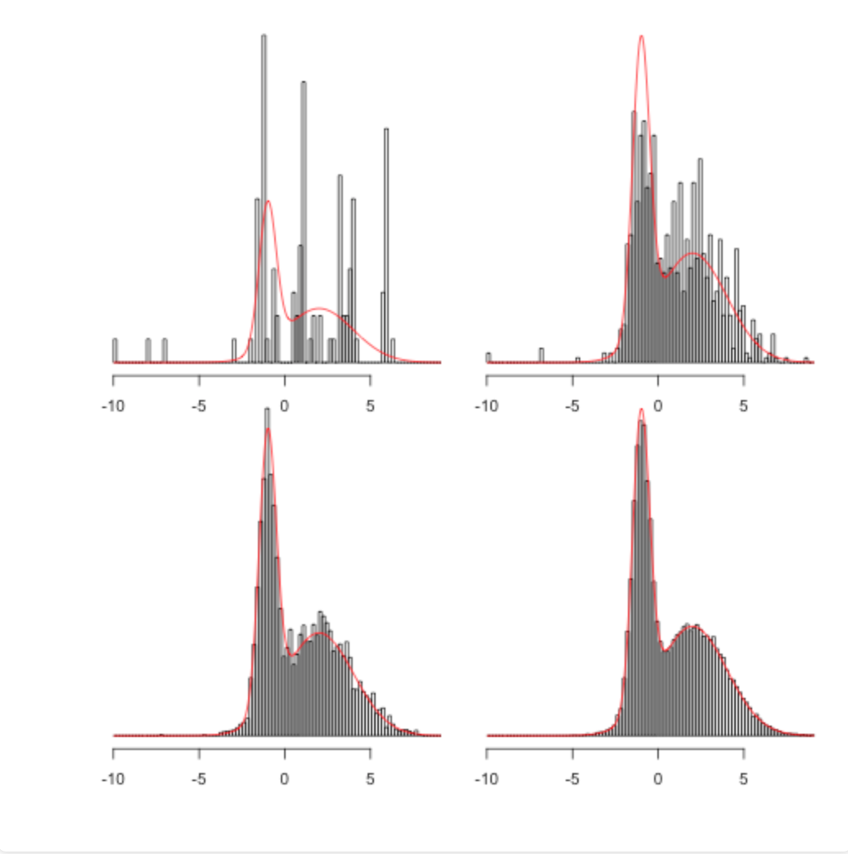
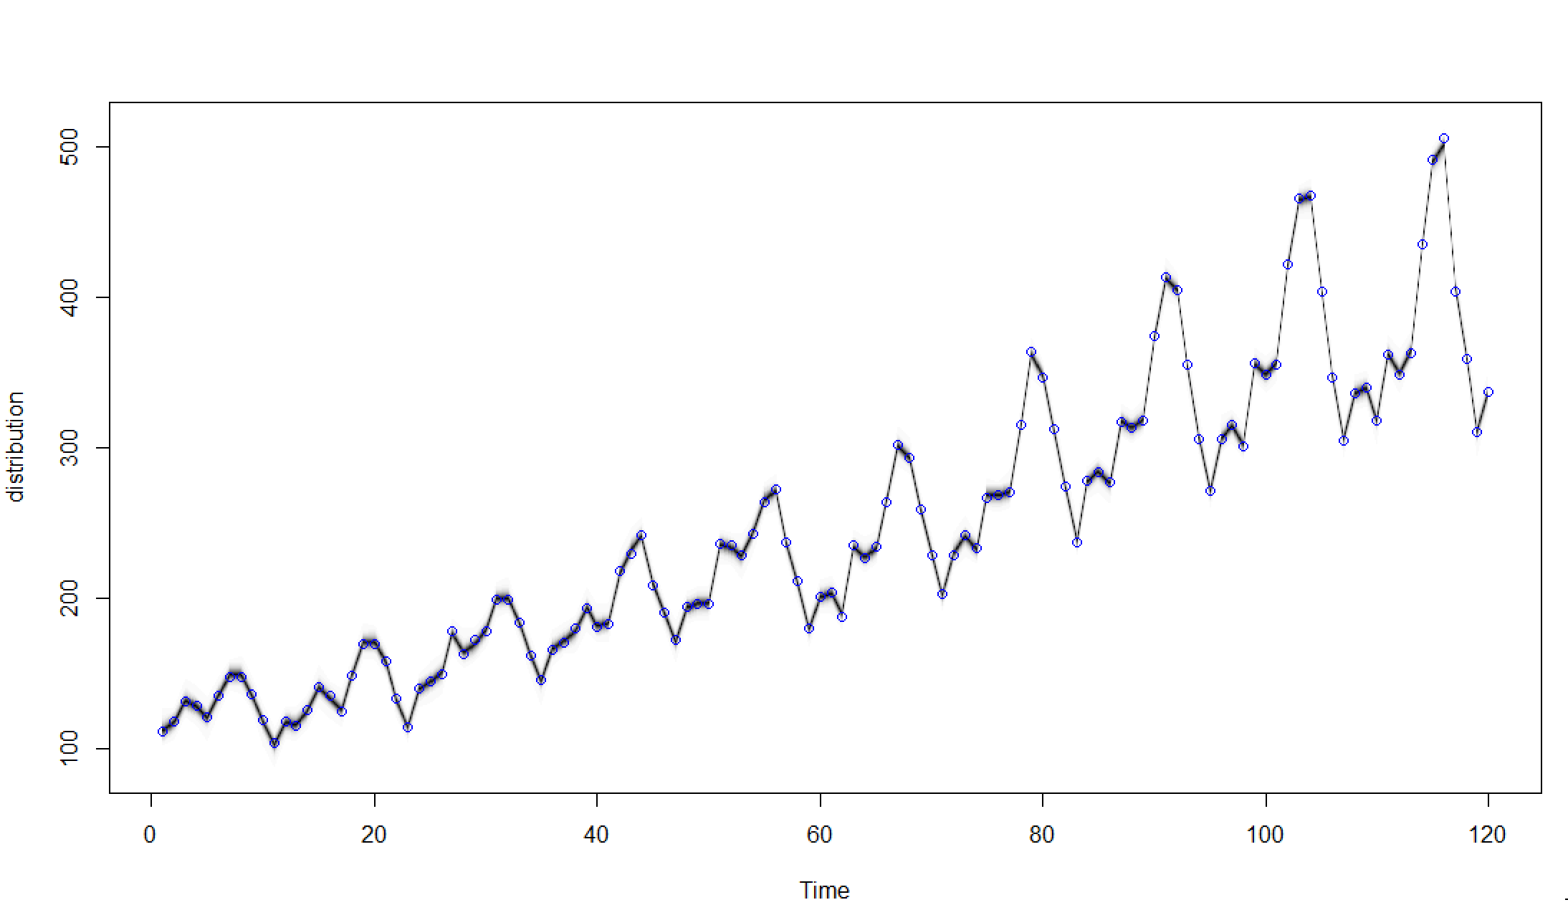
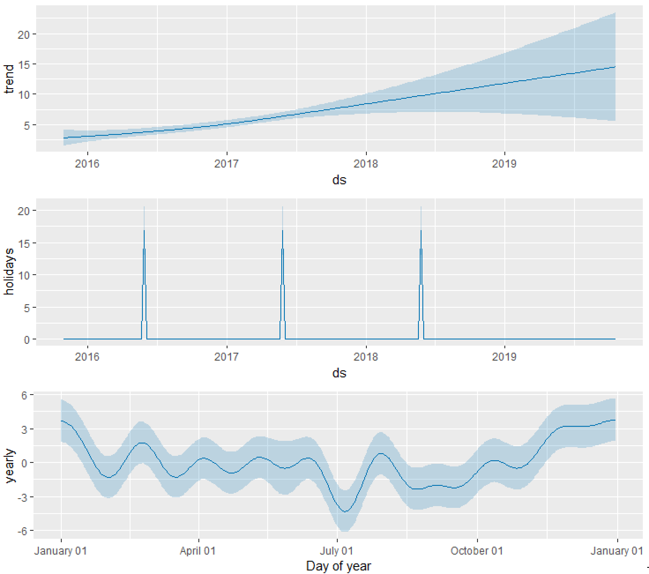
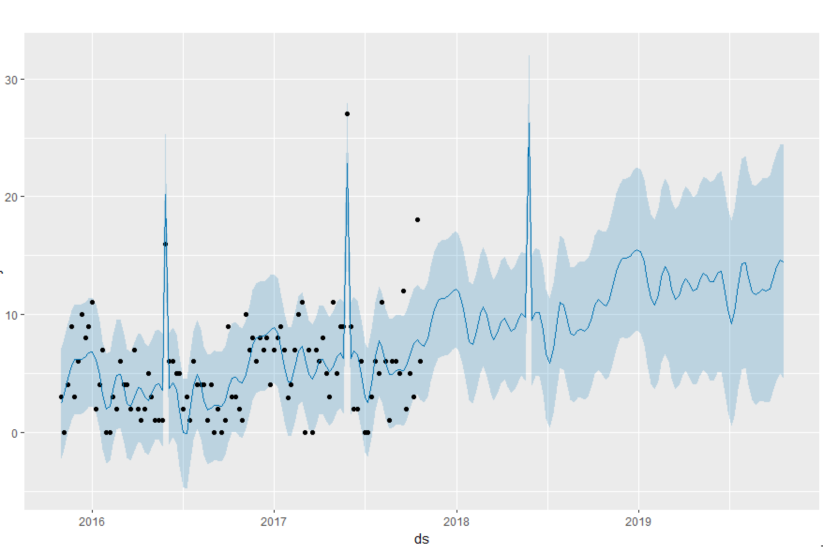
FB Prophet and BSTS under the hood part I – MCMC methods
Skander Hannachi

Slide 2
MCMC methods: gambling is not always bad
MCMC: the intuition
Monte Carlo
Markov Chain
MCMC:
Deep dive
Metropolis
Gibbs
How it is used in FB Prophet
How it is used in BSTS

Slide 3
MCMC: the intuition
MC MC
Markov Chain:
The sampling tactics used for said estimation
Randomness as a strategy for estimating complex functions from empirical data

Slide 4

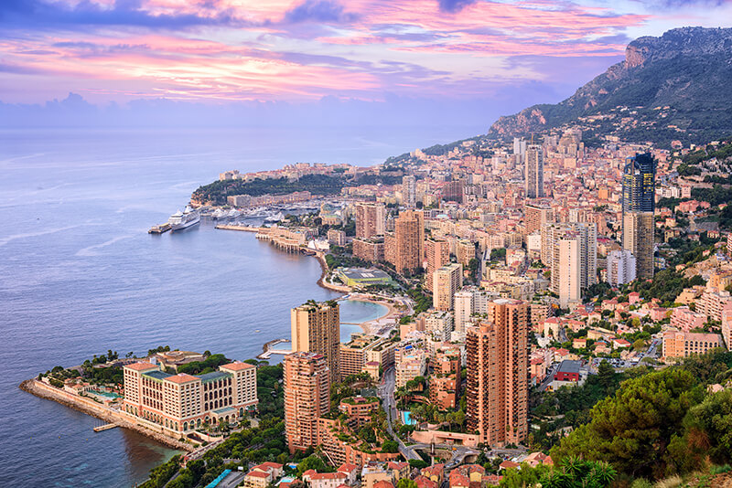
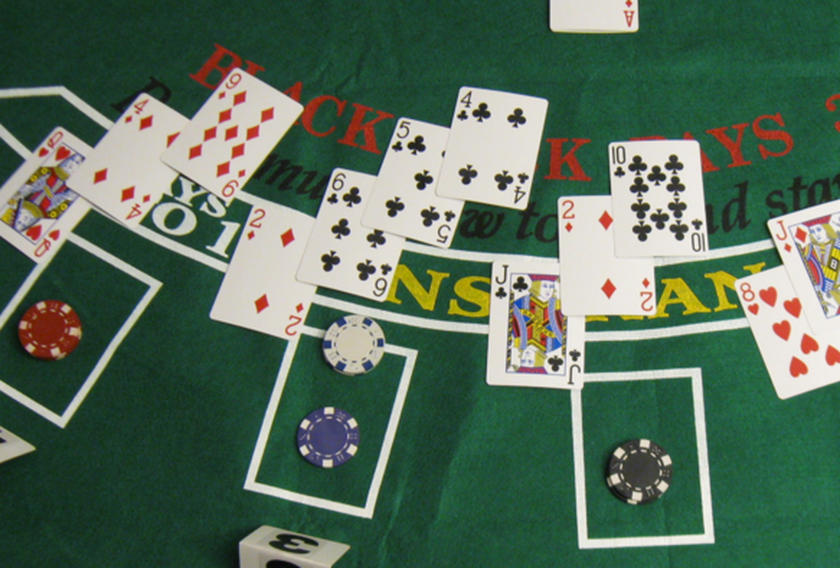
Monte Carlo sampling:

Slide 5

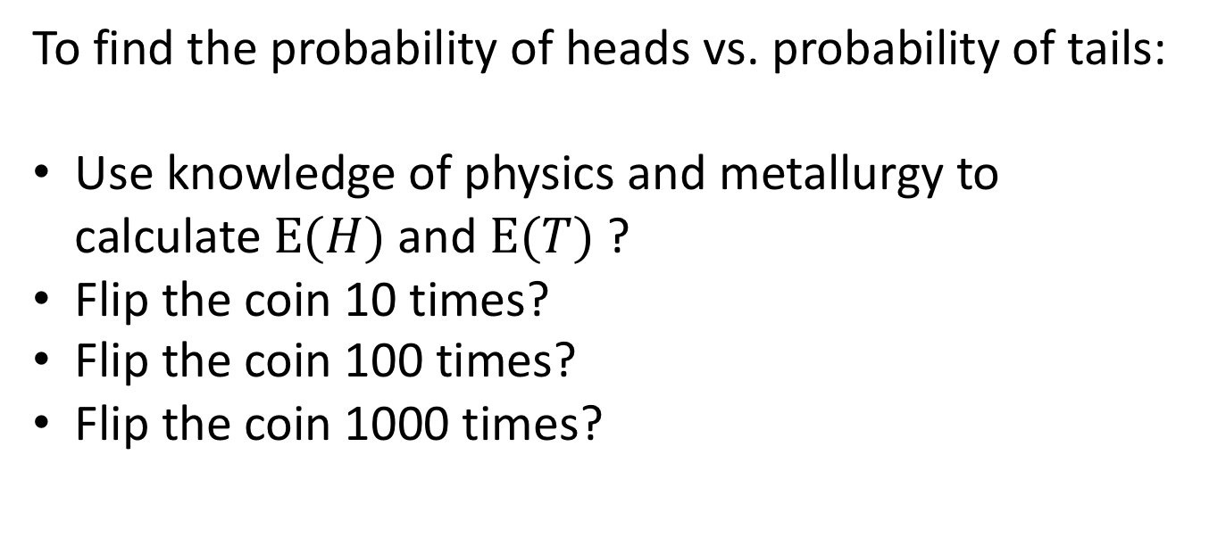
A first example: Unbalanced coin flips
To find the probability of heads vs. probability of tails:
Use knowledge of physics and metallurgy to calculate $E(H)$ and $E(T)$ ?
Flip the coin 10 times?
Flip the coin 100 times?
Flip the coin 1000 times?

Slide 6
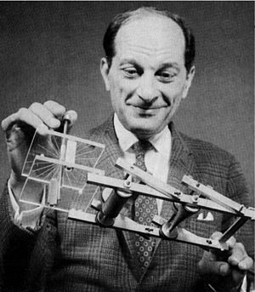
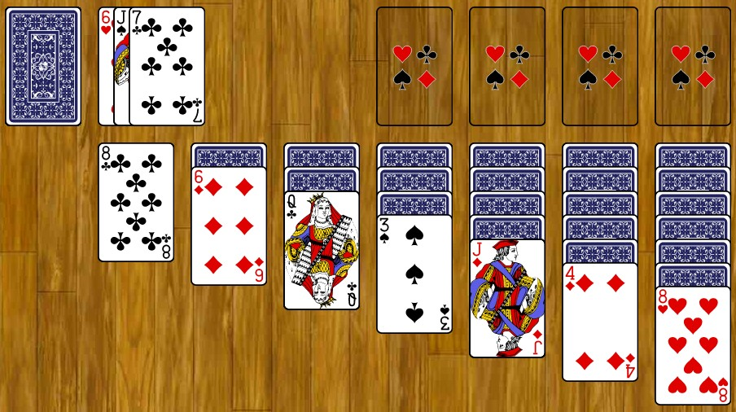
A second example: Solitaire
Stanisław Ulam
Probability of a successful outcome in solitaire?
Using combinatorics: too hard
Playing 1000s of rounds solitaire: not that easy either
Simulating 1000s of rounds solitaire on ENIAC (or AWS): totally feasible

Slide 7
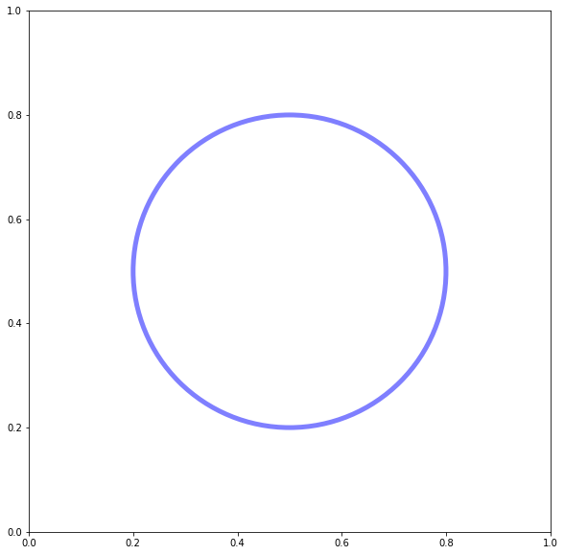
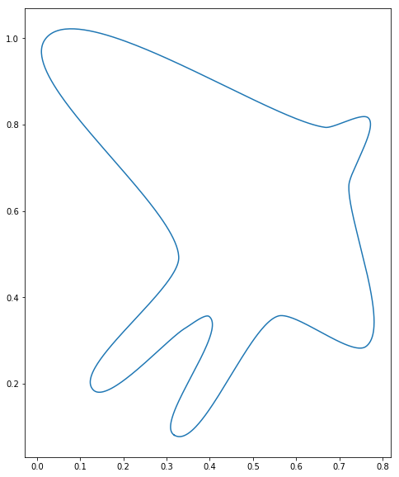
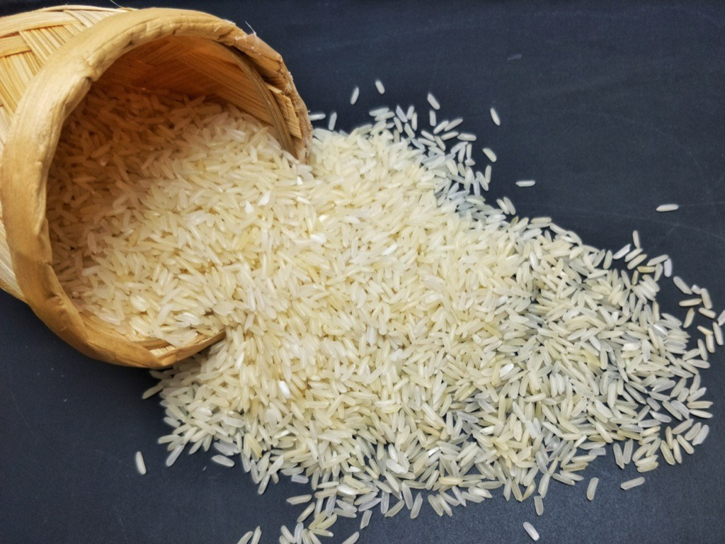
A third example: Estimating the surface (or volume) of a complex shape

Slide 8
Simulation + Randomness vs. NP-Hard problems
NP-Complete, NP-Hard problems: Difficult to solve (regardless of compute and memory)
Monte Carlo can mitigate this

Slide 9
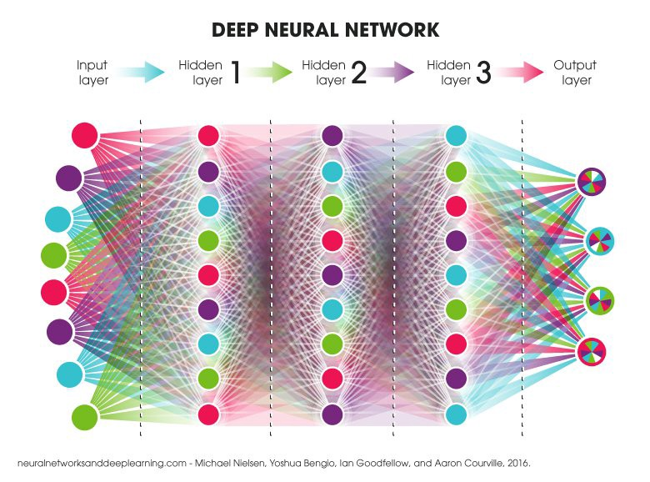
Simulation + Randomness vs. NP-Hard problems
NP-Complete, NP-Hard problems: Difficult to solve (regardless of compute and memory)
Monte Carlo can mitigate this
What other famous problem is NP-hard?

Slide 10
Optimization vs. Integration
Optimization problems!
OLS : Closed form minimization of a loss function
Gradient Descent: minimization by search of a loss function
MLE: Maximization of a likelihood function
MCMC: Integration problem!

Slide 11
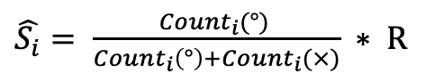
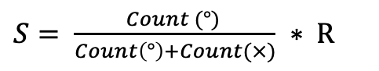
Estimating a surface: Drawing samples from a distribution
$S= \frac{Count (°) }{Count\left(°\right)+Count(×)} ∗ R$
$\hat{S_{i}}= \frac{{Count}_{i}(°) }{{Count}_{i}\left(°\right)+{Count}_{i}(×)} ∗ R$

Slide 12
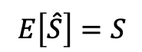
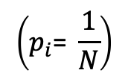
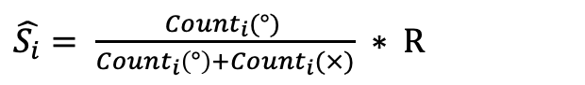
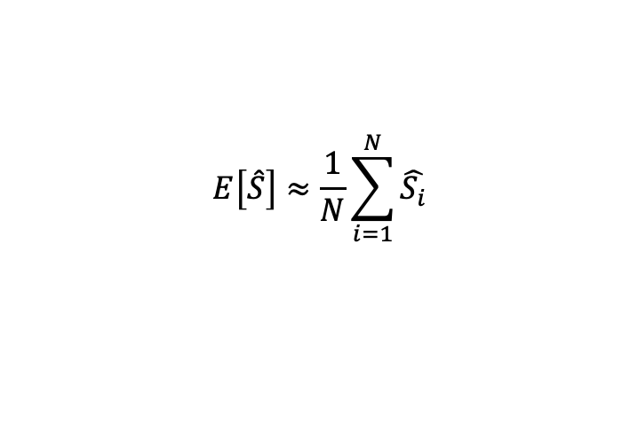
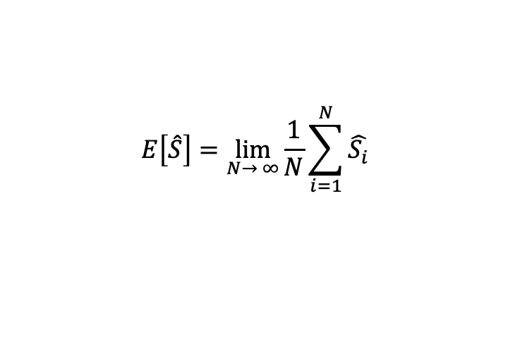
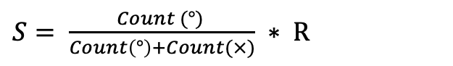
Drawing samples from a distribution – some math
$S= \frac{Count (°) }{Count\left(°\right)+Count(×)} ∗ R$
$\hat{S_{i}}= \frac{{Count}_{i}(°) }{{Count}_{i}\left(°\right)+{Count}_{i}(×)} ∗ R$
$$E\left[\hat{S}\right]=S$$
$$E\left[\hat{S}\right]=\lim_{N→ ∞}{\frac{1}{N}}\sum_{i=1}^{N}{\hat{S_{i}}}$$
$$E\left[\hat{S}\right]≈\frac{1}{N}\sum_{i=1}^{N}{\hat{S_{i}}}$$
$$\left(p_{i}\text{= }\frac{1}{N}\right)$$

Slide 13
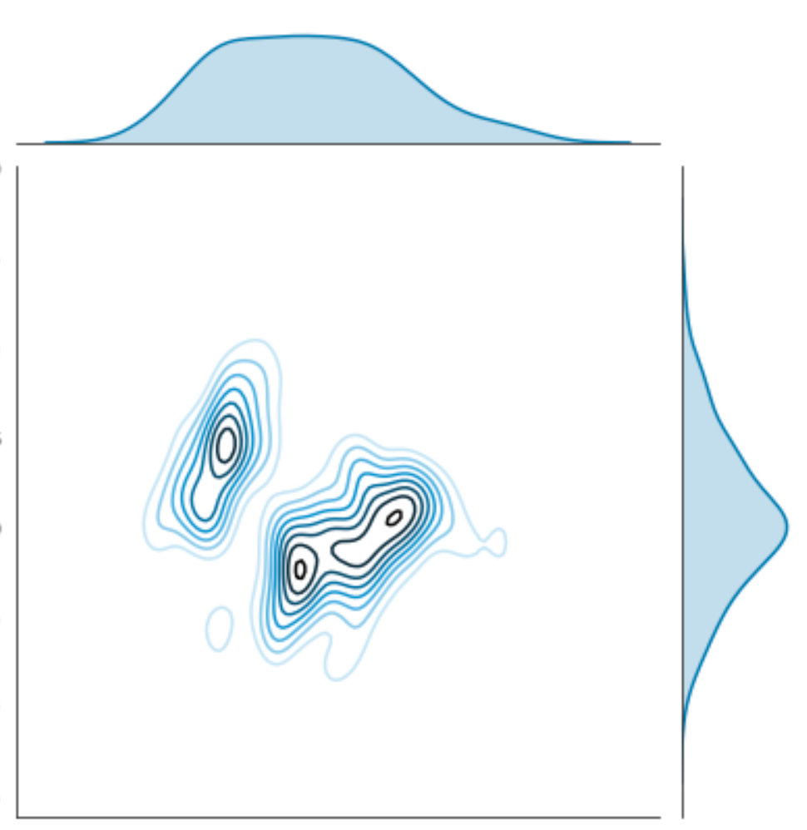
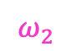
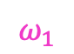
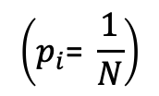
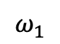
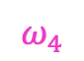
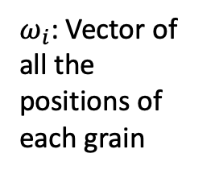
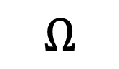
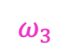
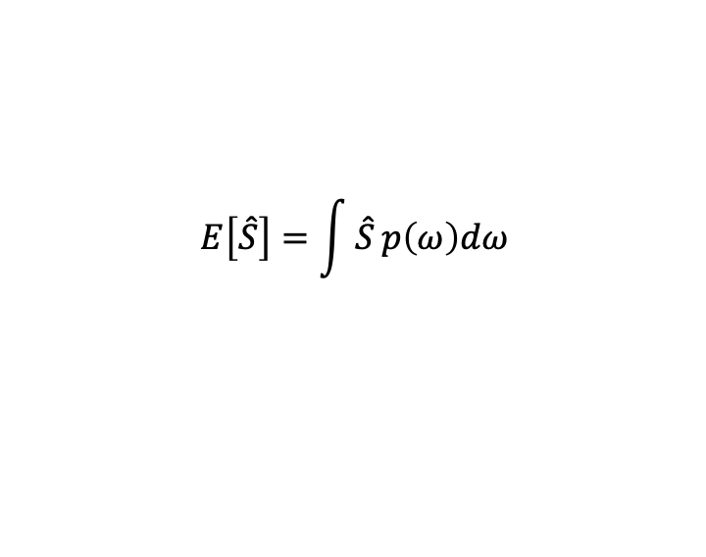
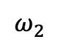
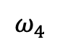
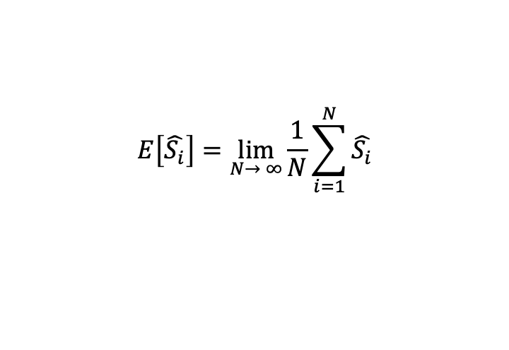
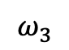
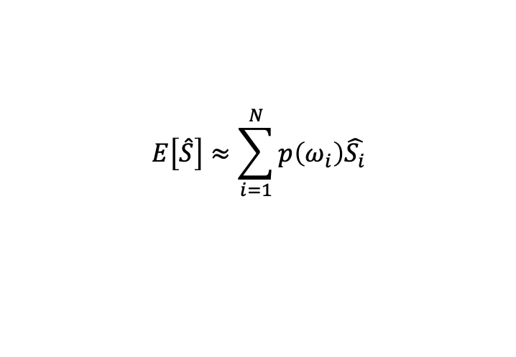
Sampling in the real world: Not so fast…
$$E\left[\hat{S_{i}}\right]=\lim_{N→ ∞}{\frac{1}{N}}\sum_{i=1}^{N}{\hat{S_{i}}}$$
$$\left(p_{i}\text{= }\frac{1}{N}\right)$$
$$ω_{1}$$
$$ω_{3}$$
$$E\left[\hat{S}\right]=\int{\hat{S}}p\left(ω\right)dω$$
$$E\left[\hat{S}\right]≈\sum_{i=1}^{N}{p\left(ω_{i}\right)\hat{S_{i}}}$$
$$Ω$$
$ω_{i}$: Vector of all the positions of each grain
$$ω_{2}$$
$$ω_{4}$$
$$ω_{2}$$
$$ω_{1}$$
$$ω_{4}$$
$$ω_{3}$$

Slide 14
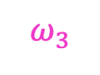

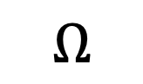
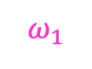
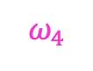
Sampling in the real world: Not all samples are good samples…..
$$ω_{1}$$
$$ω_{3}$$
$$Ω$$
$$ω_{2}$$
$$ω_{1}$$
$$ω_{4}$$
$$ω_{2}$$
$$ω_{4}$$
$$ω_{3}$$

Slide 15
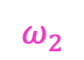
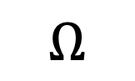
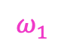
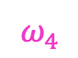
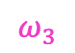
Basic sampling methods…
Rejection sampling
Just use a uniform distribution
Importance sampling
Weighted distribution
But in both cases, samples are independent
$$Ω$$
$$ω_{2}$$
$$ω_{1}$$
$$ω_{4}$$
$$ω_{3}$$

Slide 16
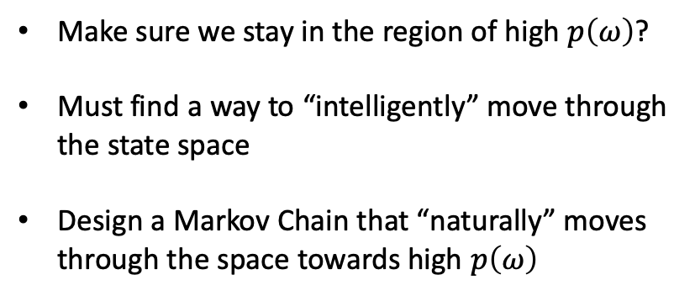
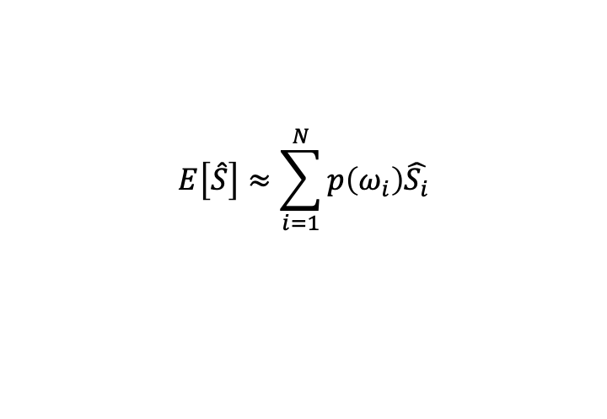
Entre Mr. Markov…..
$$E\left[\hat{S}\right]≈\sum_{i=1}^{N}{p\left(ω_{i}\right)\hat{S_{i}}}$$
$$Ω$$
Make sure we stay in the region of high $p\left(ω\right)$?
Must find a way to “intelligently” move through the state space
Design a Markov Chain that “naturally” moves through the space towards high $p\left(ω\right)$
$$ω_{2}$$
$$ω_{1}$$
$$ω_{4}$$
$$ω_{3}$$

Slide 17
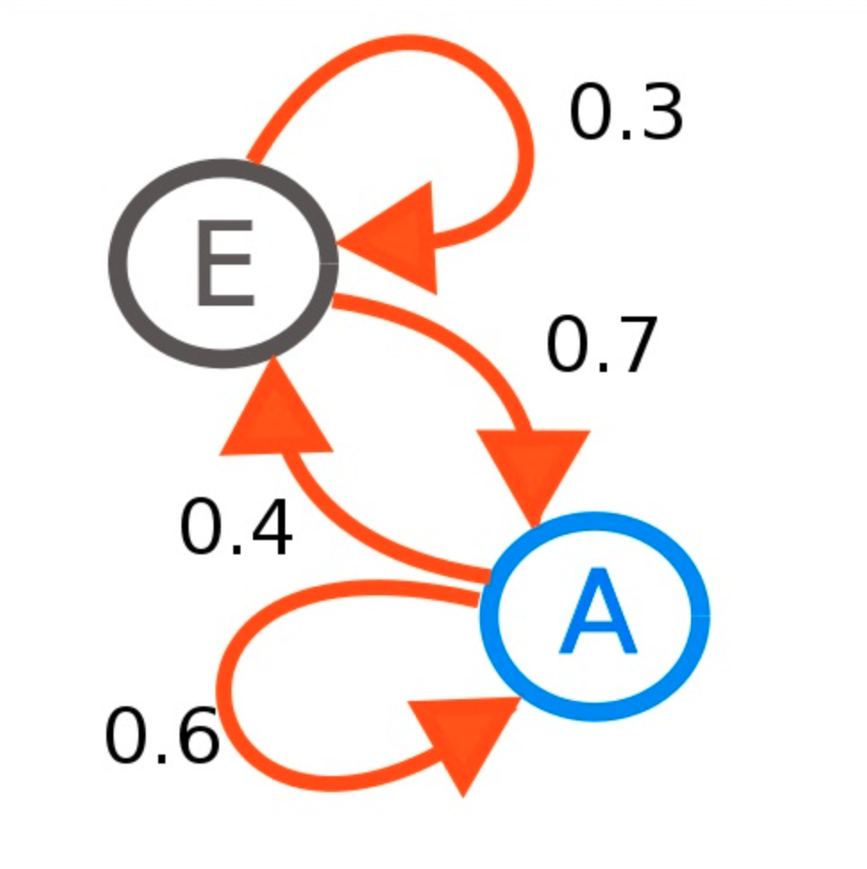
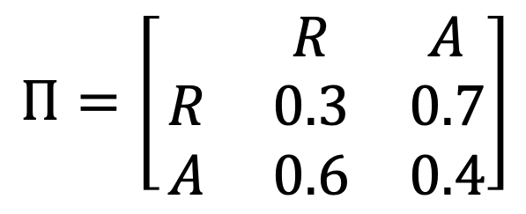

Markov Chains in 3 minutes
$$Π=\left[\begin{matrix} & R & A \\ R & 0.3 & 0.7 \\ A & 0.6 & 0.4\end{matrix}\right]$$
R
Markov property:
$P(A_{t+1}|A_{t}$,…, $A_{1}$) = $P(A_{t+1}|A_{t}$)
$P(A_{t+1}$) = $P(A_{t}$) $Π$
Stationary distribution:
$P_{s}$= $P_{s}Π$
Can we find $Π$ such that :
$P_{s}$= $max⁡(p(ω))$ ?
A

Slide 18





Metropolis-Hastings algorithm:
R
Initialize $ω_{0}$
For i = 0 to N-1 :
Sample u ~ U[0,1]
Sample $ω^{∗}$~ $q\left(ω^{∗} | ω_{i}\right)$
If $u<min⁡\{1,\frac{p\left(ω^{∗}\right)}{p\left(ω_{i}\right)}\}$:
$ω_{i+1}=$ $ω^{∗}$
Else:
$ω_{i+1}=$ $ω_{i}$
$$Ω$$
$$ω_{0}$$
A
$$ω_{2}$$
$$ω_{1}$$
$$ω_{N}$$

Slide 19







Gibbs algorithm:
R
Initialize $ω_{0}$
For i = 0 to N-1 :
$ω_{i+1,1}\text{\sim }p\left(ω_{i,1} | ω_{i,2…K}\right)$
$ω_{i+1,2}\text{\sim }p\left(ω_{i,2} | ω_{i,1,3…K}\right)$
$ω_{i+1,3}\text{\sim }p\left(ω_{i,3} | ω_{i,1,2,4,…K}\right)$
.
.
.
$ω_{i+1,k}\text{\sim }p\left(ω_{i,1} | ω_{1…K−1}\right)$
$$ω_{0,1}$$
$$Ω$$
$$ω_{1,1}$$
A
$$ω_{2,1}$$
$$ω_{1,2}$$
$$ω_{2,2}$$
Metropolis-Hastings: Euclidean distance.
Gibbs: Manhattan distance.

Slide 20











Burn In:
Burn in
$$Ω$$
$$Ω$$
$$ω_{0,1}$$
$$ω_{1,1}$$
$$ω_{0}$$
$$ω_{2}$$
$$ω_{2,1}$$
$$ω_{1,2}$$
$$ω_{1}$$
$$ω_{2,2}$$
$$ω_{N}$$
BSTS: “Burn-in”
FB Prophet: “Warm up”

Slide 21
It is not just about surfaces and volumes (although it kind of is….)

Slide 22



Facebook Prophet:
MAP (MLE’s more elegant cousin) / L-BFGS
MCMC

Slide 23



BSTS (now called STS):
MCMC all around!!!

Slide 24
Tools
Very likely a bunch of R stuff
PyMC3
Tensorflow probabilities
Stan
Thank you for your time!!!!

